Slide 1
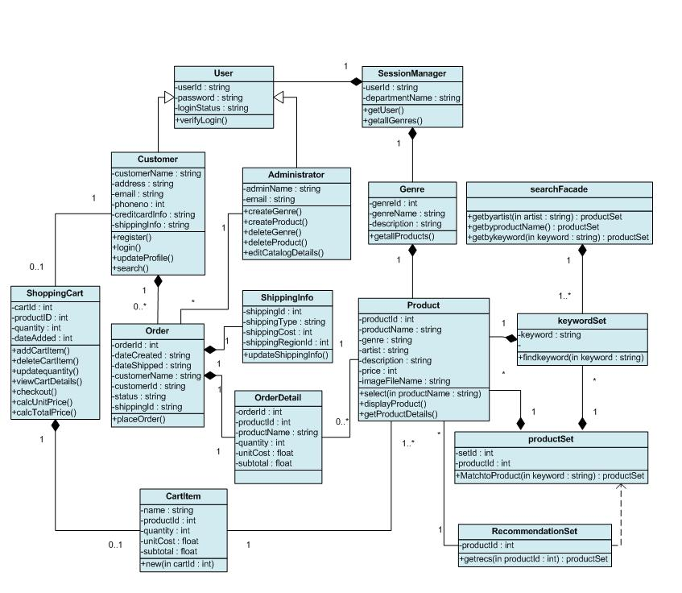


CMSC 2133 Object Oriented Programming Java
Prof. David North

Slide 2
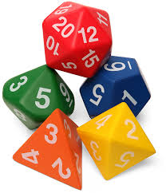
Project 1
Review Requirements
Identify Objects
Build Object Model
Build 1.1 & Test
Build 1.2 & Test

Slide 3
Java Questions?
How to do Random numbers?

Slide 4
Random Class
Java Random Class
Part of the java.util package
Include java.util (Reuse)
Generates random numbers
Methods
Random()
float nextFloat() – returns float between 0.0 and 1.0
int nextInt – returns a integet between 0 and largest int
int nextInt( int num) return an integer >= 0 and <= num-1.

Slide 5
Random Class
Random gen = new Random();
// number 1 to 10
num = gen.nextInt(10)+1;

Slide 6
Random Class
Random gen = Random();
// number 1 to 10
num = generator.nextInt(10)+1;

Slide 7
Random Class
Random gen = Random();
// set the random seed value
gen.setSeed(System.currentTimeMillis());
gen.setSeed(1234567);
// number 1 to 10
num = generator.nextInt(10)+1;

Slide 8
Program Example 6

Slide 9
Project 1
Review Requirements
Identify Objects
Build Object Model
Build 1.1 & Test
Build 1.2 & Test

